Slide 1
BURGLAR ALARM SYSTEM
ANALOG ELECTRONICS PROJECT
VAIBHAV RAJ SAHNI 2K19/CO/419
VAIBHAV VASHISHT 2K19/CO/420

Slide 2
01
INTRODUCTION
02
CIRCUIT COMPONENTS
03
IC 555 TIMER
04
IC 555 TIMER AS ASTABLE MULTIVIBRATOR
05
CIRCUIT DIAGRAM AND EXPLANATION
CONTENTS

Slide 3
CIRCUIT COMPONENTS
COMPONENT | QUANTITY
IC 555 TIMER | 2
RESISTOR(GENERIC) 1K ohm | 2
RESISTOR(GENERIC) 10K ohm | 3
REISTOR(GENERIC) 50 ohm | 1
CAPACITOR(GENERIC) 100nF | 2
CAPACITOR(GENERIC) 50uF | 1
CAPACITOR(GENERIC) 0.47uF | 1
POLARISED CAPACITOR(GENERIC) | 1
SPEAKER | 1
In order to understand the working of our circuit, we first need to have a basic understanding of the IC 555 timer which works as an Astable Multivibrator and drives the speaker.

Slide 4




Along with the IC 555 timer, we have used multiple resistors and capacitors in our circuit which help us control the frequency of the sound produced by the speaker.
We have used a polarised capacitor which helps us filter out the DC signal and only gives AC square wave as input to the speaker.
We also have used a generic speaker which takes the square wave as input and produces a sound as an output. It helps us to alarm the user if any burglar tries to invade the user’s private property.
Resistor
Capacitor
Polarised capacitor
Speaker

Slide 5
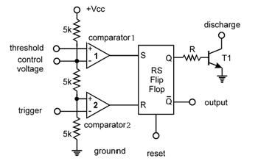
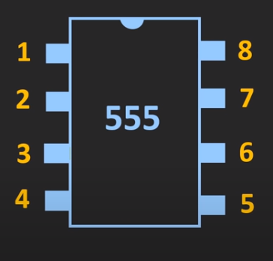

The 555 timer IC is an integrated circuit (chip) used in a variety of timer, delay, pulse generation, and oscillator applications. Here, we use it as an Astable Multivibrator. The IC 555 timer consists of 8 pins as shown.
IC 555 TIMER
Ground
$$V_{CC}$$
Trigger
Discharge
The internal block diagram of the 8 PIN IC 555 timer
Output
Threshold
Reset
Control

Slide 6
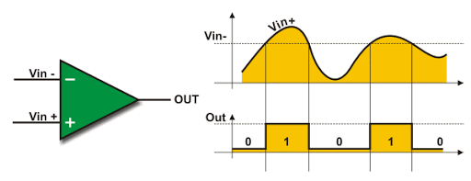
COMPONENTS OF THE IC 555 TIMER :
ANALOG COMPARATOR
A comparator is used to compare a measurable quantity with a reference or standard such as two voltages or currents. It outputs a digital signal as shown in the diagram.
The output of the comparator is HIGH when the voltage on the non-inverting
input(+) is greater than the voltage on the inverting input(-), and LOW when the non-inverting input is less than the inverting input voltage, as is evident from the above diagram.

Slide 7
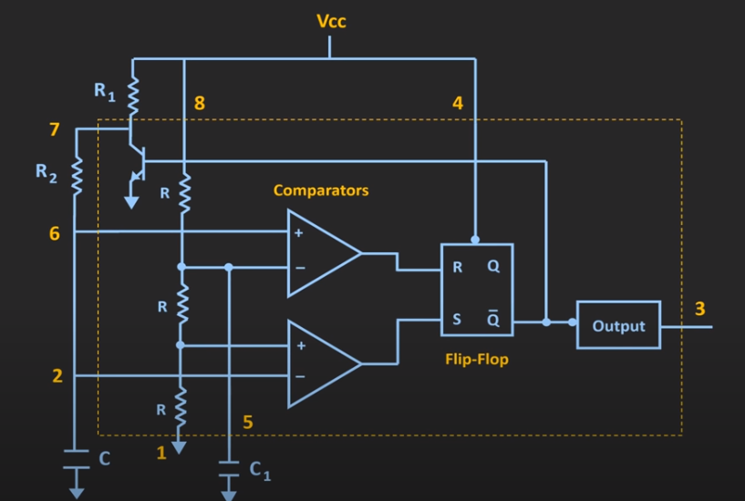
SR FLIP FLOP
The SR flip-flop is basically a one-bit memory bistable device that has two inputs: S and R. S will “SET” the device (meaning the output = “1”), while R will “RESET” the device (meaning the output = “0”).
The below table shows the output of the SR flip-flop:
S | R | Q(t+1)
0 | 0 | Q(t)
0 | 1 | 0
1 | 0 | 1
1 | 1 | -

Slide 8
BIPOLAR JUNCTION TRANSISTOR
A Bipolar Junction Transistor (BJT) is a semiconductor device used to amplify or switch electronic signals and electrical power. It consists of two PN-junctions and three terminals namely, theEmitter (E), the Base (B) and the Collector (C) respectively.
In the IC 555 Timer, it is used in common base configuration where its collector terminal is connected to the discharge pin 7 and the emitter terminal is connected to the ground. The BJT acts as a switch in the IC 555 timer circuit.

Slide 9
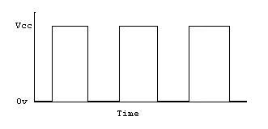
IC 555 TIMER AS AN ASTABLE MULTIVIBRATOR
Astable Multivibrator is a circuit element which has two states and is not stable in either state, i.e. it continuously switches from one state to the other. It is used to produce a square wave output as given below.

Slide 10
ASTABLE MULTIVIBRATOR CIRCUIT
This is the DISCHARGE pin. The base of the transistor is connected to Q’. When Q’ is 1, the transistor is switched on and the capacitor C starts discharging through the
transistor.
This is the RESET pin. A low voltage (less than 0.7V) applied to this pin will cause the output (pin 3) to go low. This input should remain connected to Vcc when not used in order to prevent any unwanted resetting of the output.
CHARGING
DISCHARGING
This is the THRESHOLD pin. The comparator gives output 1 (high) when voltage at this pin exceeds 2/3Vcc and output 0 (low) when voltage at this point is below 2/3Vcc.
This is the OUTPUT pin. In output low state, the voltage will be close to 0V. In output high state, the voltage will be 1.7V lower than the supply voltage.
This is the TRIGGER pin. The comparator gives output 1(high) when voltage at this pin is below 1/3 Vcc and output 0 (low) when voltage at this point is above 1/3Vcc.
This is the CONTROL pin. It can be used to vary the output frequency in astable mode. When not in use, it is recommended that this input be connected to the ground via a capacitor.

Slide 11
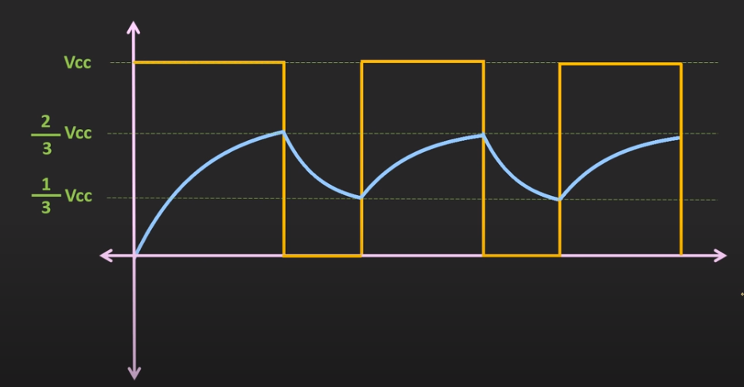
T2(Charging time = 0.693 * (R1+R2)C
of the capacitor)
T1(Discharging time = 0.693 * (R2)C
of the capacitor)
Total time period = T1 + T2
= (0.693)*(R1 + 2*R2)*C
Frequency of the = 1/T
Output square = 1.44/(R1+2R2)*C
wave
This graph represents the charging of the capacitor.
The yellow lines represents the output voltage while the blue line represent the charging of the capacitor.
T1
T2

Slide 12
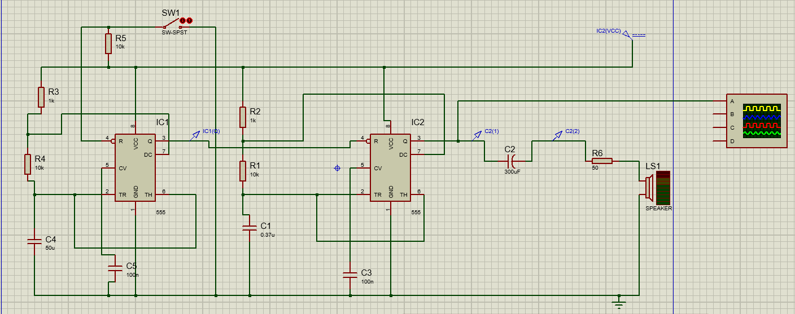
CIRCUIT DIAGRAM
Here when the trip wire is intact and not broken, the reset pin will be in low state and therefore output of the IC1 will be inactive. When an intruder entering the user’s house breaks this trip wire, resistor R1 pulls the reset pin to high logic and immediately the output will become active.
Timer IC₁ is used here in astable mode in such a way that square-wave output at about 1.3 Hz is obtained.
F1 = 1.44/(R1+2R2)*C=[1.44(1K+2*10K)50u]Hz=1.3Hz
IC₂ is also configured in astable mode, but it gives an output with about 145Hz frequency.
F2 = 1.44/(R1+2R2)*C=[1.44(1K+2*10K)0.37u]Hz=145Hz
The output of IC₁ (pin 3) is connected to ‘Reset’ terminal (pin 4) of IC₂. So, this continuous 145Hz tone of IC₂ is interrupted by the 1.3 Hz signal from IC₁,thus, producing a ‘beeping’ sound.

Slide 13
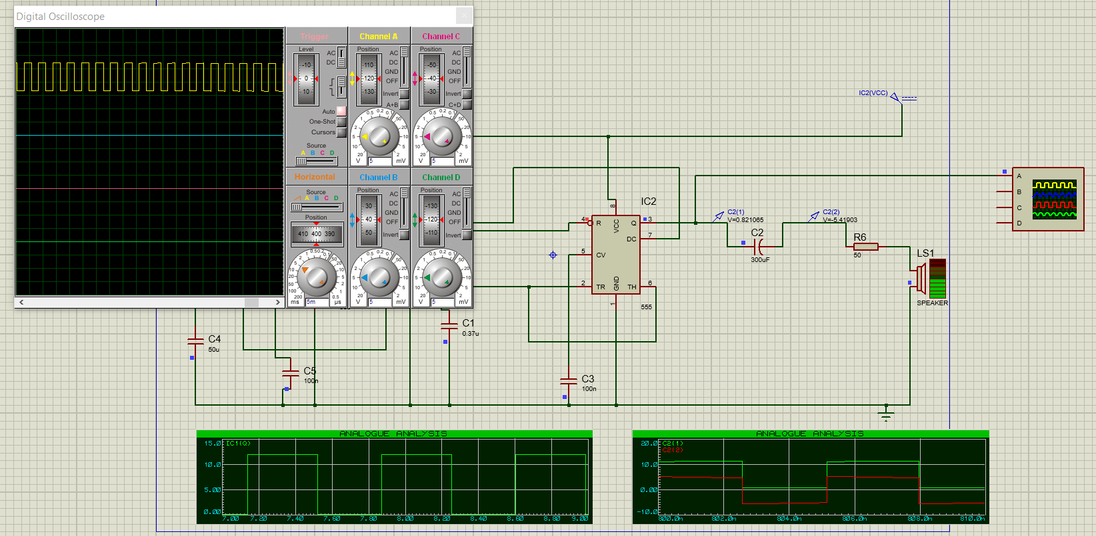
OUTPUT THROUGH OSCILLOSCOPE

Slide 14
THANK YOU

